Slide 1
Artificial Intelligence (AI)
Topic 1: Foundations of AI and Intelligent Agents (Part- IV)

Slide 2
Agenda
Agent and Environments
Rationality
PEAS(Performance measure, Environment, Actuators, Sensors)
Agent Types
Learning Outcomes : Intelligent Agents
Methodology and Assessment Criteria for the Subject

Slide 3
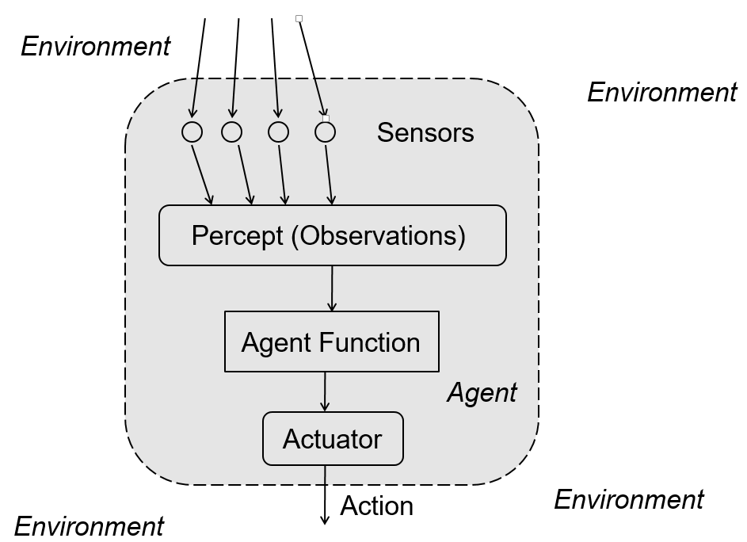

Slide 4
PEAS : Automated Taxi Driver
Agent Type | Performance Measure | Environment | Actuators | Sensors
Taxi | Safe, Fast, Legal, Comfortable trip, maximise profits | Roads, Pedestrians, Customers, other traffic | Steering, accelerator, break, signal horn, display | Cameras, Sonar, speedometer, odometer, GPS, Accelerometer, Engine Sensors, Keyboard

Slide 5
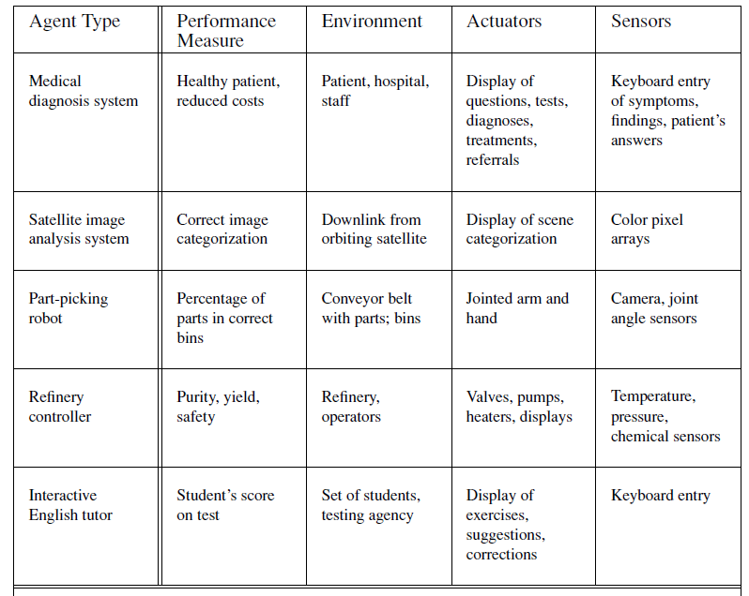
PEAS : Other Examples

Slide 6
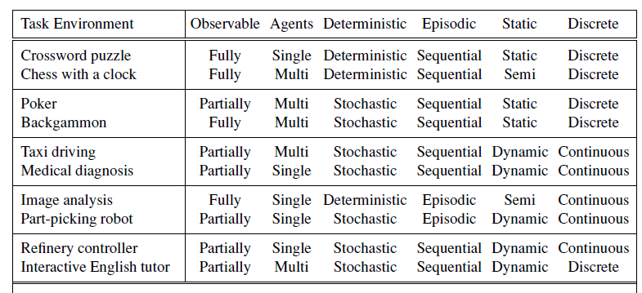
Properties of Task Environments

Slide 7
Structure of An Agent
Agent = architecture + program
Architecture = some sort of computing device (sensors + actuators)
(Agent) Program = some function that implements the agent mapping = “?”
Agent Program = Job of AI

Slide 8
Agent programs
Input for Agent Program
Only the current percept
Input for Agent Function
The entire percept sequence
The agent must remember all of them
Implement the agent program as
A look up table (agent function)

Slide 9
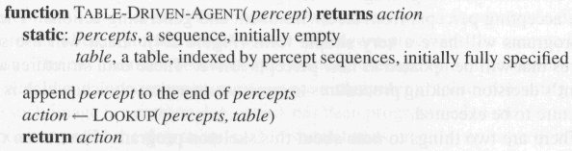
Agent Programs (1)
Skeleton design of an agent program

Slide 10
Agent Programs (3)
Despite of huge size, look up table does what we want.
The key challenge of AI
Find out how to write programs that, to the extent possible, produce rational behavior
From a small amount of code
Rather than a large amount of table entries
E.g., a five-line program of Newton’s Method
V.s. huge tables of square roots, sine, cosine, …

Slide 11
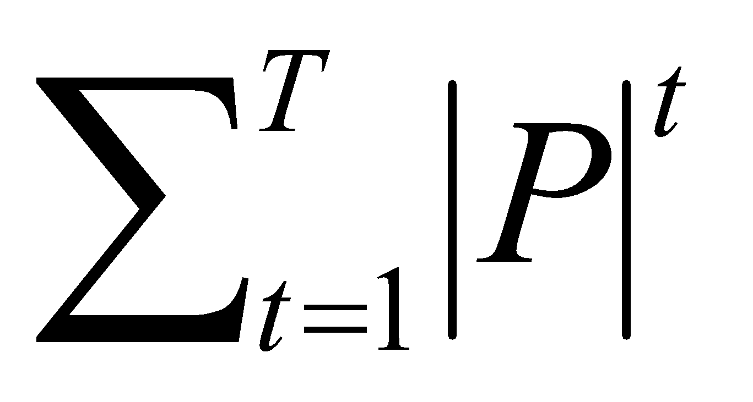
Agent Programs (2)
P = the set of possible percepts
T= lifetime of the agent
The total number of percepts it receives
Size of the look up table
Consider playing chess
P =10, T=150
Will require a table of at least 10¹⁵⁰ entries

Slide 12
Types of agent programs
Four types
Simple reflex agents
Model-based reflex agents
Goal-based agents
Utility-based agents

Slide 13
Simple reflex agents (1)
It uses just condition-action rules
The rules are like the form “if … then …”
efficient but have narrow range of applicability
Because knowledge sometimes cannot be stated explicitly
Work only
if the environment is fully observable

Slide 14
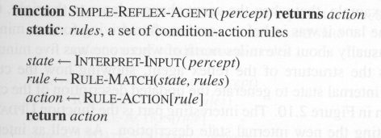
Simple reflex agents (2)

Slide 15
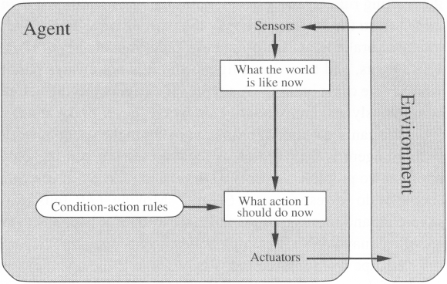
Simple reflex agents (3)

Slide 16

A Simple Reflex Agent in Nature
percepts
(size, motion)
RULES:
(1) If small moving object,
then activate SNAP
(2) If large moving object,
then activate AVOID and inhibit SNAP
ELSE (not moving) then NOOP
needed for
completeness
Action: SNAP or AVOID or NOOP

Slide 17
Model-based Reflex Agents
For the world that is partially observable
the agent has to keep track of an internal state
That depends on the percept history
Reflecting some of the unobserved aspects
E.g., driving a car and changing lane
Requiring two types of knowledge
How the world evolves independently of the agent
How the agent’s actions affect the world

Slide 18
Example of Internal State (1)
IF
THEN
Saw an object ahead, and turned right, and it’s now clear ahead | Go straight
Saw an object Ahead, turned right, and object ahead again | Halt
See no objects ahead | Go straight
See an object ahead | Turn randomly

Slide 19
Example of Internal State (1)
start
Actions: left, right, straight, open-door
Rules:
If open(left) & open(right) and open(straight) then
choose randomly between right and left
If wall(left) and open(right) and open(straight) then straight
If wall(right) and open(left) and open(straight) then straight
If wall(right) and open(left) and wall(straight) then left
If wall(left) and open(right) and wall(straight) then right
If wall(left) and door(right) and wall(straight) then open-door
If wall(right) and wall(left) and open(straight) then straight.
(Default) Move randomly

Slide 20
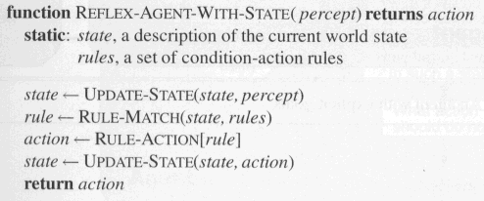
Model-based Reflex Agent Program
The agent is with memory

Slide 21
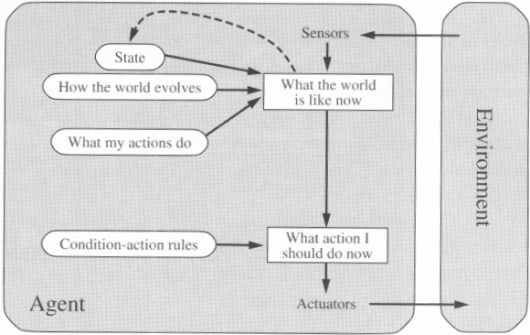
Model-based Reflex Agents

Slide 22
Goal-based agents (1)
Current state of the environment is always not enough
The goal is another issue to achieve
Judgment of rationality / correctness
Actions chosen goals, based on
the current state
the current percept

Slide 23
Goal-based agents (2)
Conclusion
Goal-based agents are less efficient
but more flexible
Agent 🡨 Different goals 🡨 different tasks
Search and planning
two other sub-fields in AI
to find out the action sequences to achieve its goal

Slide 24
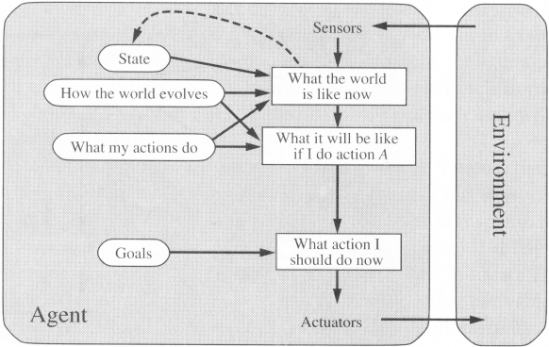
Goal-based agents (3)

Slide 25
Utility-based agents
Goals alone are not enough
to generate high-quality behavior
E.g. meals in Canteen, good or not ?
Many action sequences the goals
some are better and some worse
If goal means success,
then utility means the degree of success (how successful it is)

Slide 26
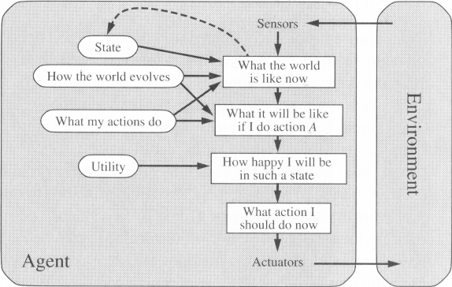
Utility-based agents (1)

Slide 27
Learning Agents (1)
After an agent is programmed, can it work immediately?
No, it still need teaching
In AI,
Once an agent is done
We teach it by giving it a set of examples
Test it by using another set of examples
We then say the agent learns
A learning agent

Slide 28
Learning Agents (2)
Four conceptual components
Learning element
Making improvement
Performance element
Selecting external actions
Critic
Tells the Learning element how well the agent is doing with respect to fixed performance standard.
(Feedback from user or examples, good or not?)
Problem generator
Suggest actions that will lead to new and informative experiences.

Slide 29
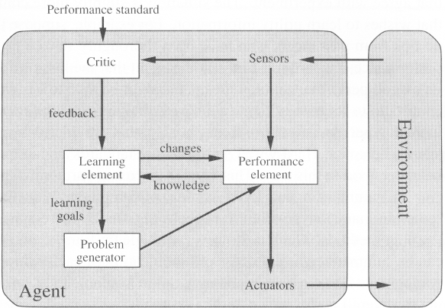
Learning Agents (3)

Slide 30
Learning Outcomes with the Topic
Understanding of Task Environments
Designing an Agent

Slide 31
Methodology And Assessment Criterias
Class Assignment(s)
Each chapter being covered will have one assignment. The Case Studies will be given in line to the Changing with Speed across IT Projects in Kirirom
Internal Exam(s)
There will be 2 exams
Model Exam
There will be one Model Exam.
Semester Exam
There will be 1 Semester Exam

Slide 32
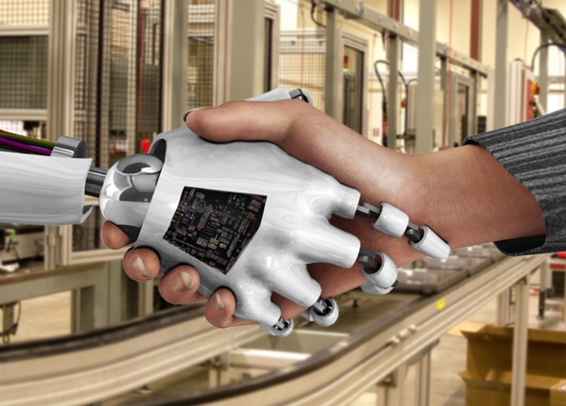
Thank You !
“Liberty according to metaphysics is self-determining power in an intellectual agent. It implies thought and choice and power
- John Adams “

